Slide 1

Remote Code Execution with Wifi Duck
Drew Newton

Slide 2
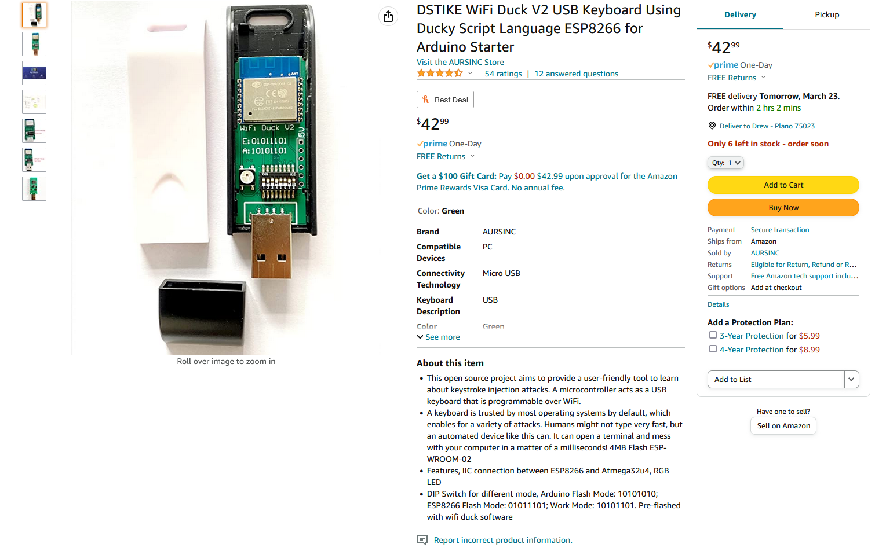
Wifi Duck
Modified USB Rubber Ducky
Designed to be recognized as a keyboard so that whatever device it is connected to trusts it implicitly and allows keystroke input.
My own personal Raspberry Pi projects were what really led me to this course so I thought it would be fitting to make a little hacking gadget as my final project to close out the class!

Slide 3
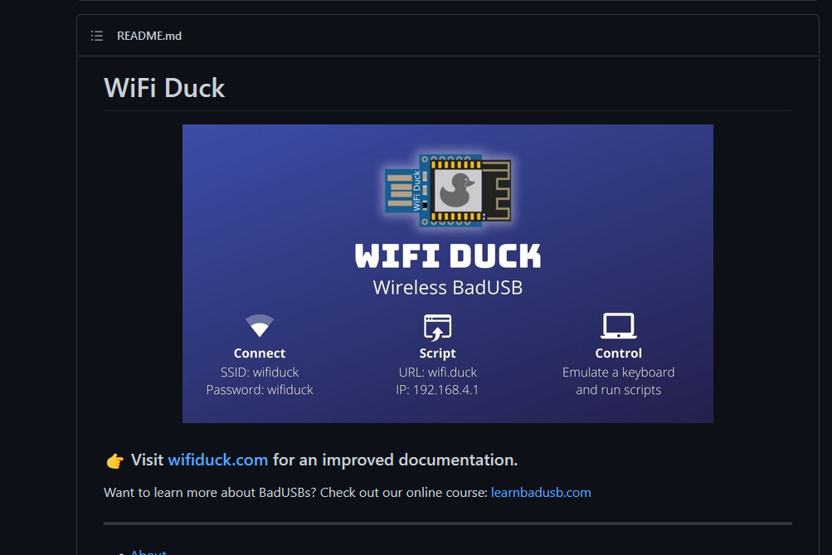
Designing My Duck
https://github.com/SpacehuhnTech/WiFiDuck

Slide 4
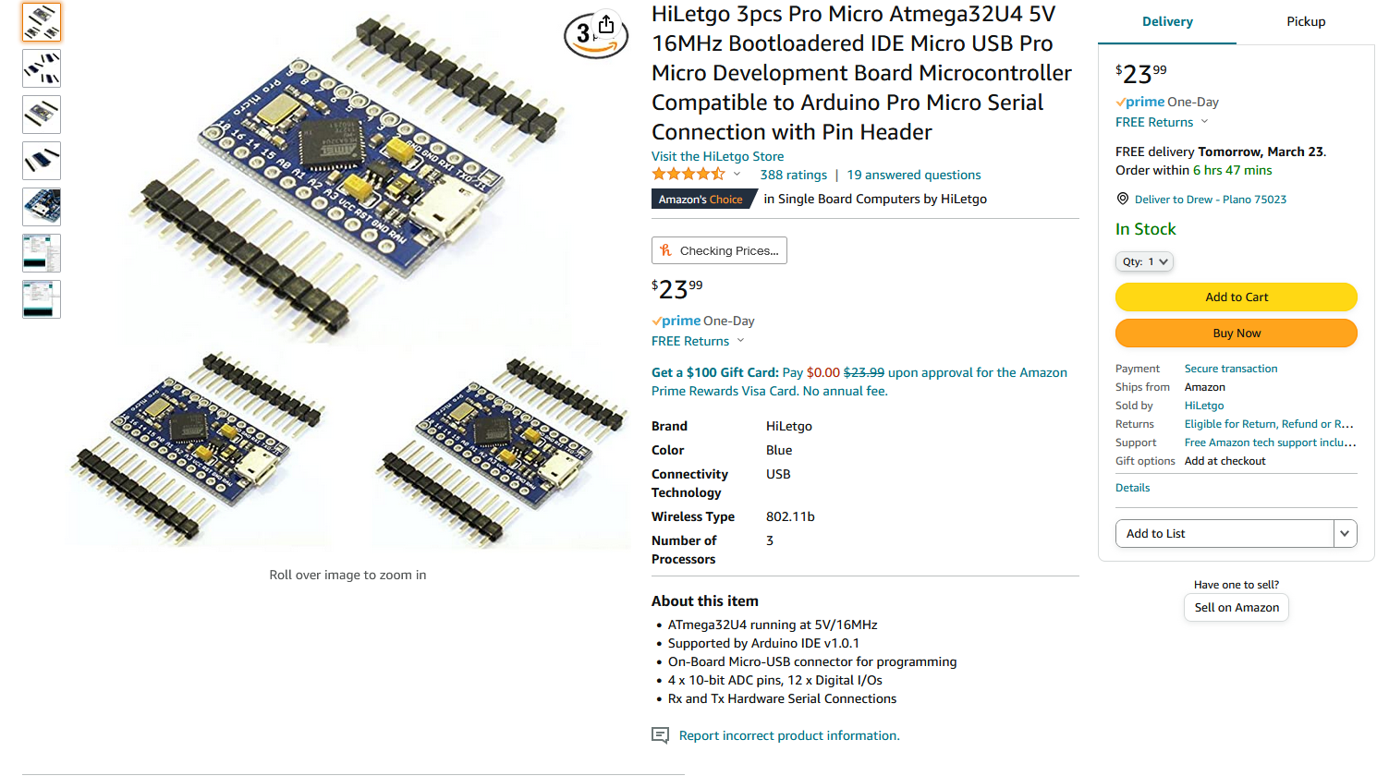
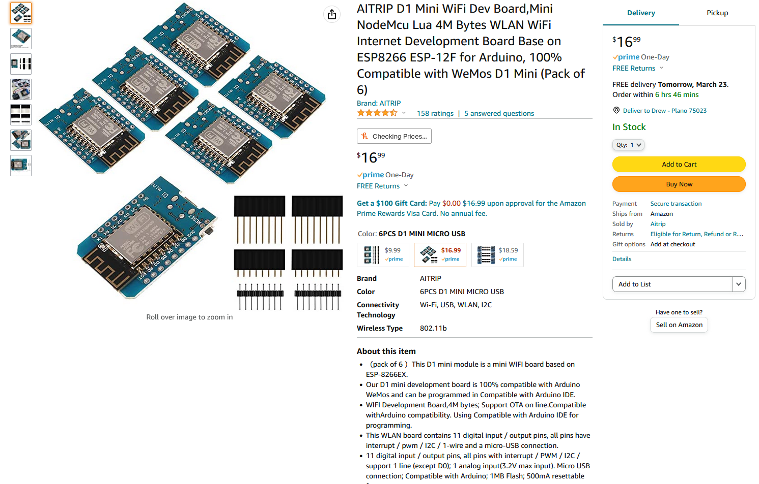
Development Boards
Notes:
Pro Micro is an atmega32u4 for usb power and informations transfer and d1 mini is a wifi controller

Slide 5
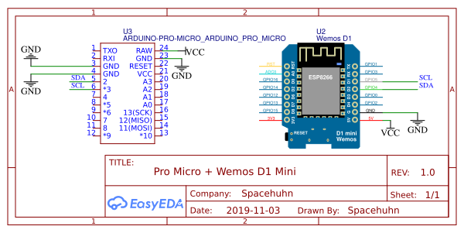
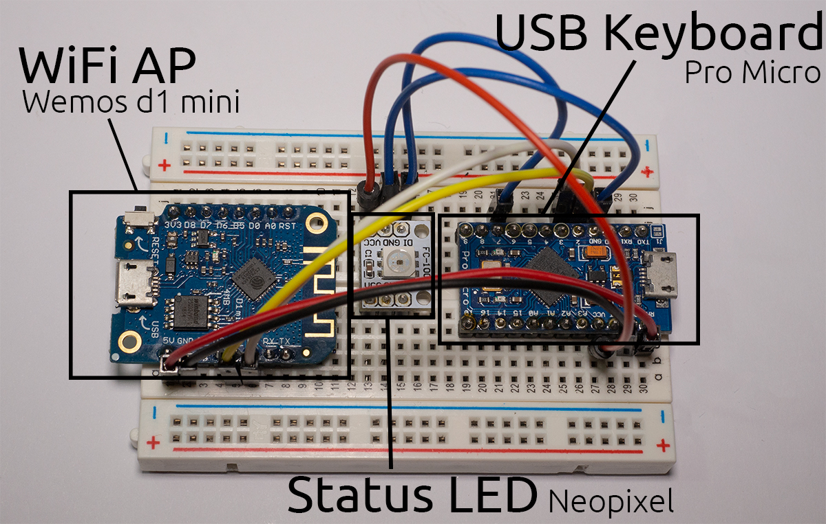
Printed Circuit Board vs. Development Board
PCBs are compact and sleek but must be made to order and require soldering to make the proper connections.
Using a breadboard is easy but clunky and difficult to use discreetly.
The exact PCB schematics that I used can be found here: https://oshwlab.com/Spacehuhn/wifi-duck

Slide 6

Soldering
Notes:
Start discussing the issues that came up with the different prototypes.
Soldering problems
Power surge on USB hub

Slide 7
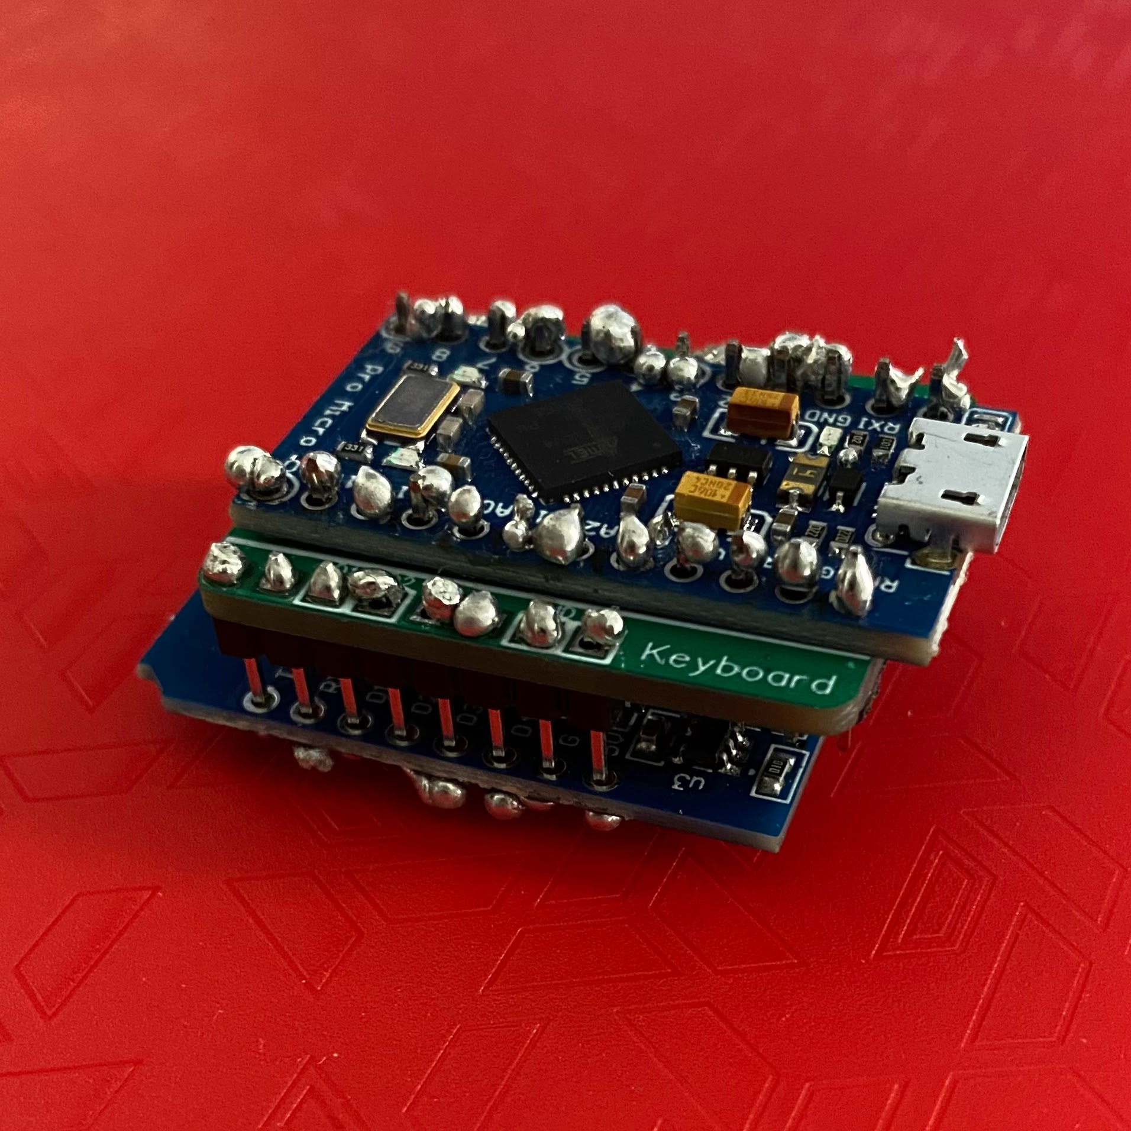
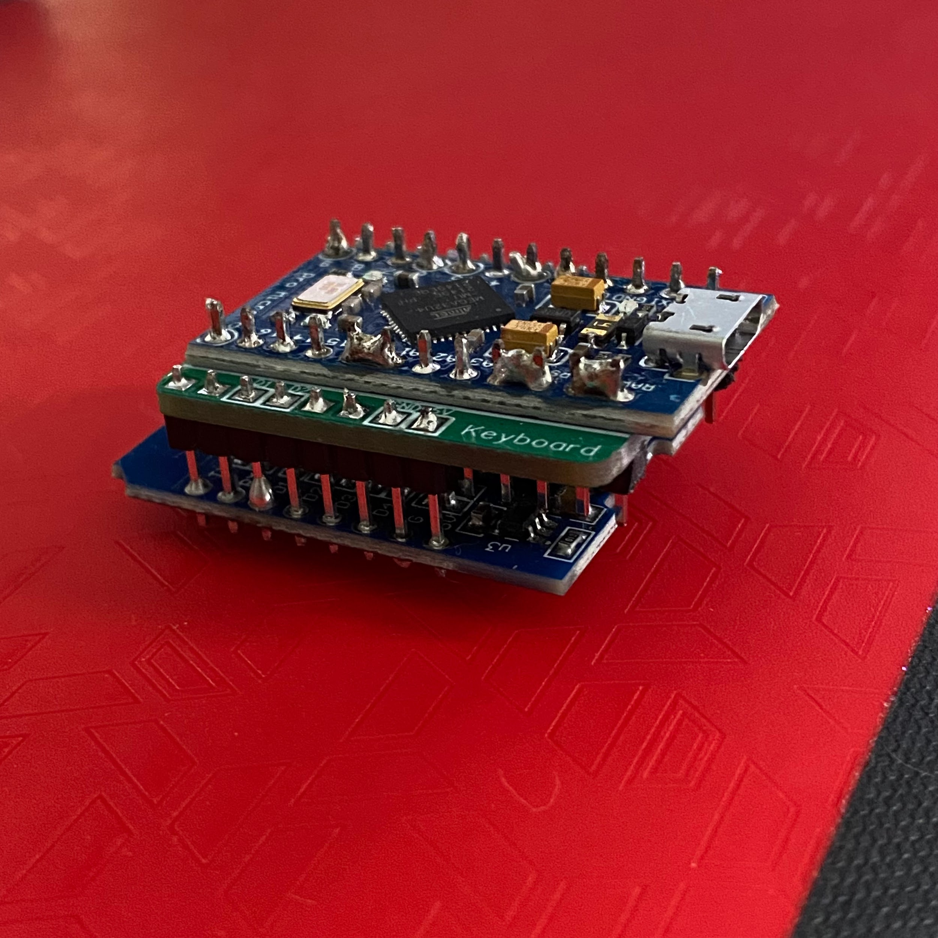
Prototypes and Construction Issues
Notes:
Version 1 on the left. Soldered together but the pro micro had trouble flashing the software.
Flashed Version 2 before soldering but then found out my usb hub was giving me issues with power surges

Slide 8
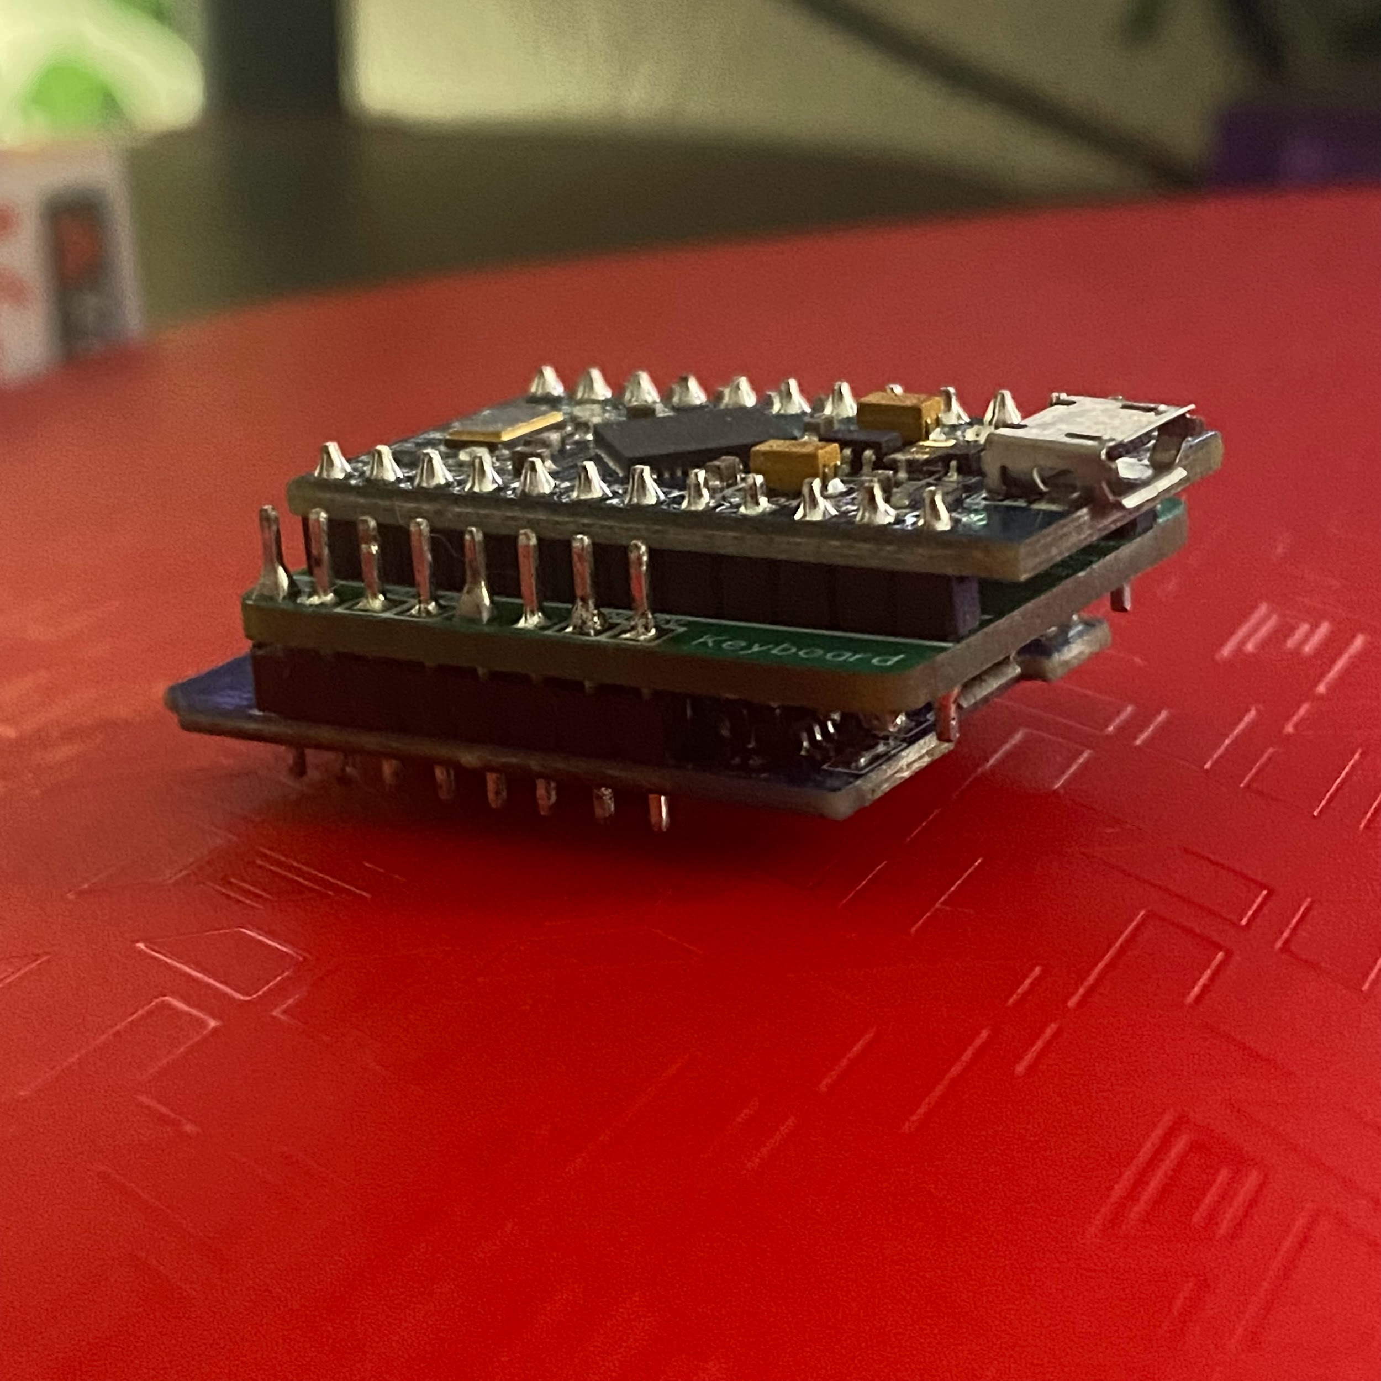
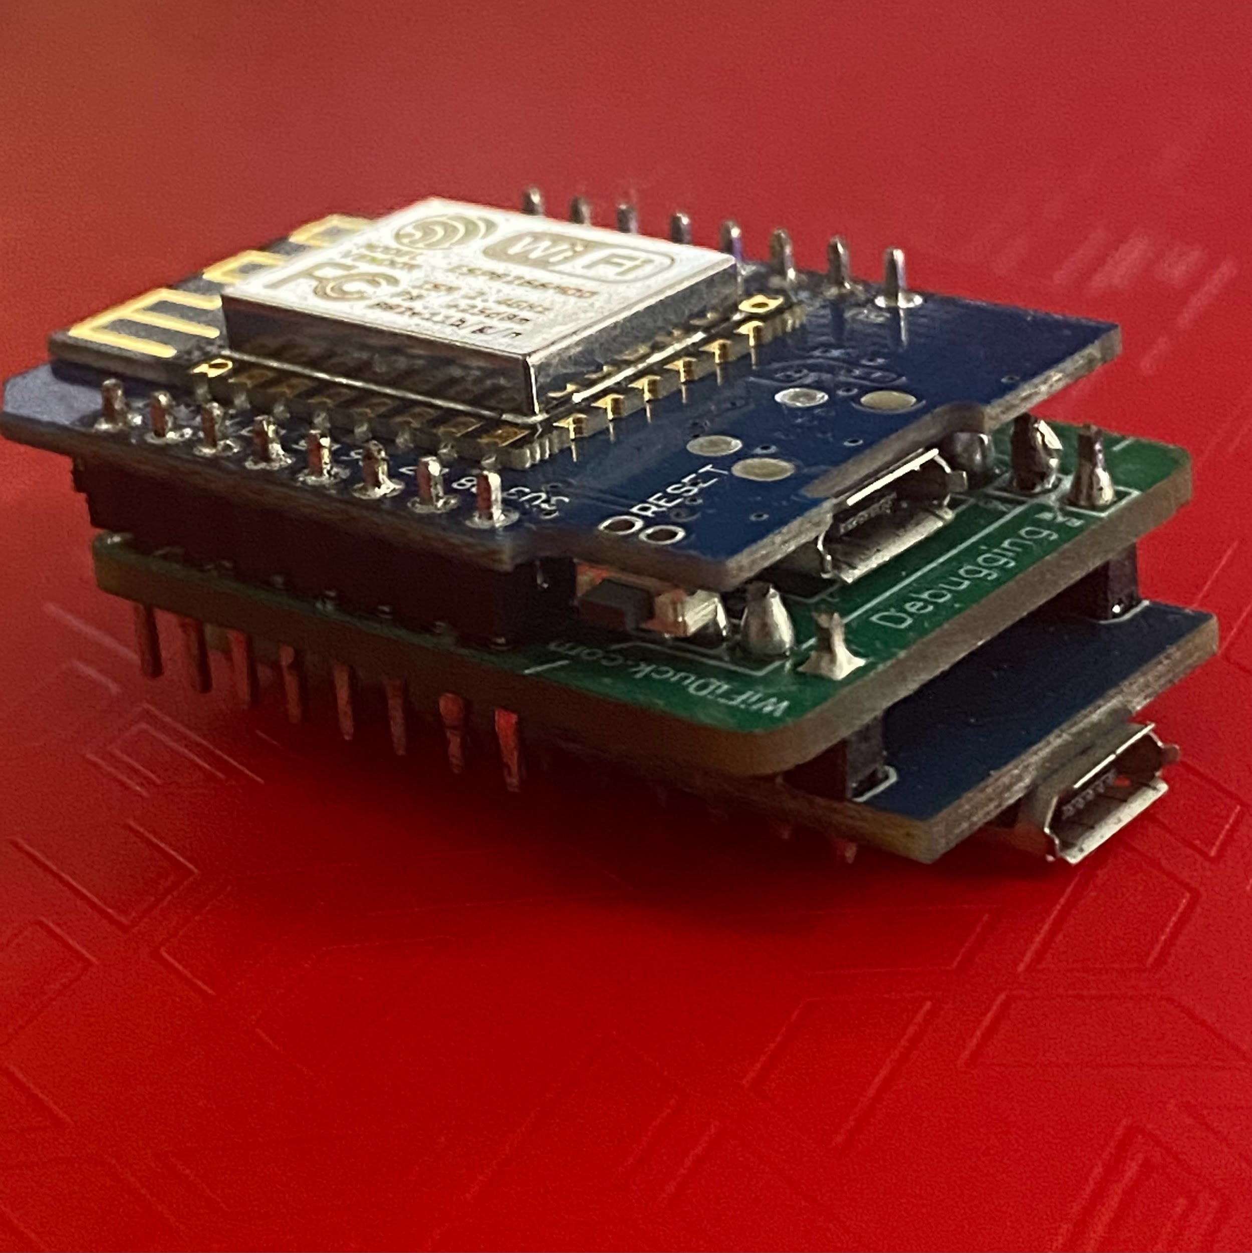
Final Product
Notes:
Final version looks neat and great
Soldered the boards too close and had to use solder pump to make space for my usb cable

Slide 9
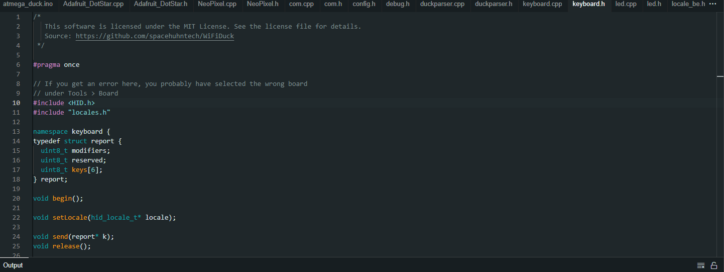
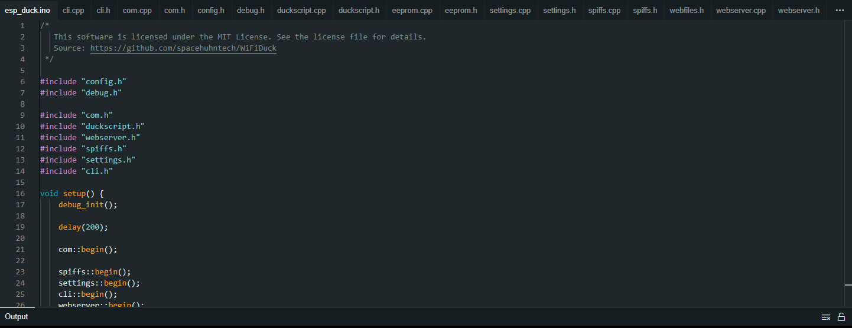
Arduino IDE
HID, or Human Interface Device configuration in the atmega source code is how the Wifi Duck tells the operating system that it should be recognized as a keyboard.
Notes:
Top picture shows the #include HID.h which is what mimics a keyboard
Configure the development boards and their port under tools and flash the software

Slide 10
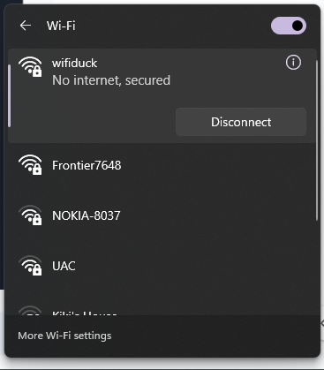
Connecting
The Wemos D1 mini establishes a wifi network that you can connect to with your attacking device.

Slide 11
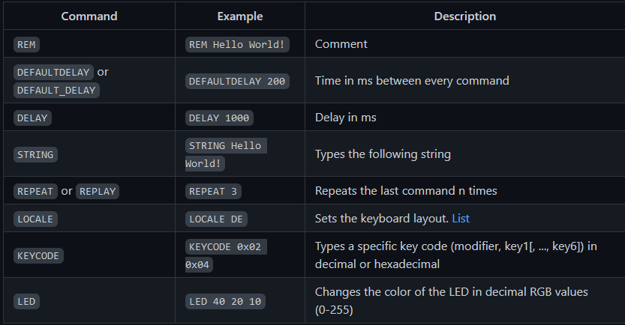
Ducky Script
Ducky Script was created by Hak5 for use with the USB Rubber Ducky and has been integrated with the Wifi Duck.
Notes:
Created by Hak5 for rubber ducky. Show specifics such as delays.

Slide 12
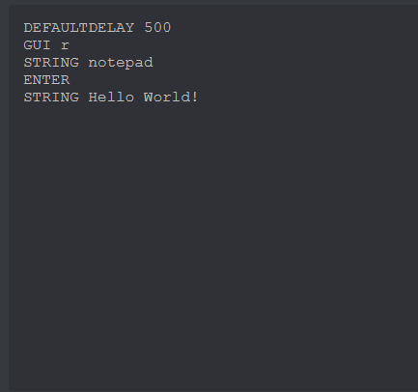
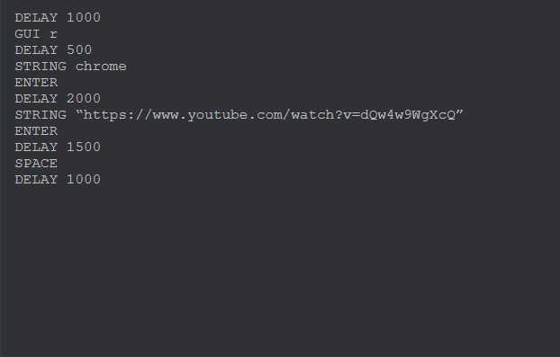
Demonstration
Notes:
Troubleshoot scripts with different delay times

Slide 13
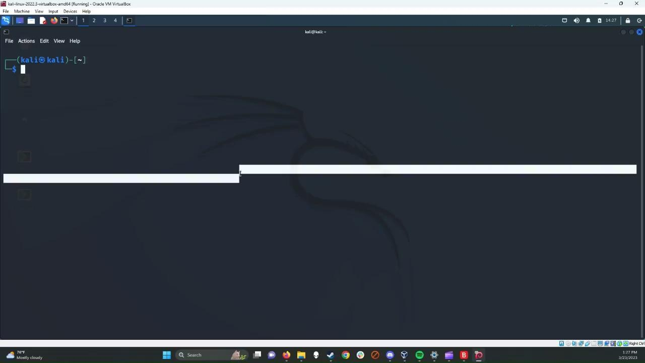
Reverse Shell Demo: Windows
Notes:
More serious implications of the wifi duck include remote access that can give attackers more versatility

Slide 14
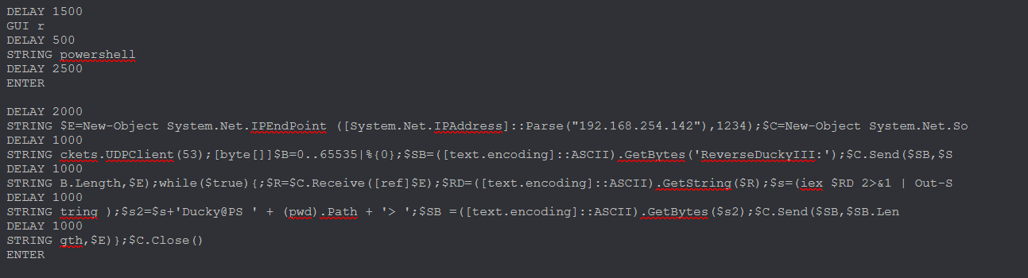
Reverse Shell Ducky Script: Windows
Notes:
Establishes a UDP connection with the specified IP over port whatever

Slide 15
Reverse Shell Demo: Linux

Slide 16
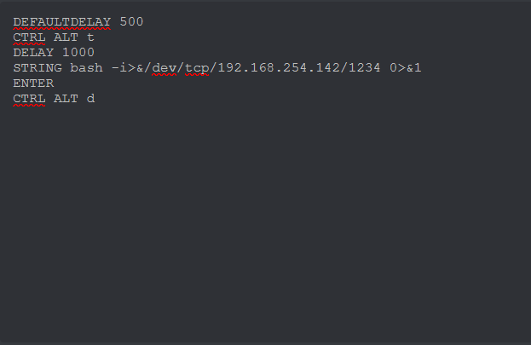
Reverse Shell Ducky Script Linux
Notes:
Sets up a tcp connection with the specified ip address and port

Slide 17
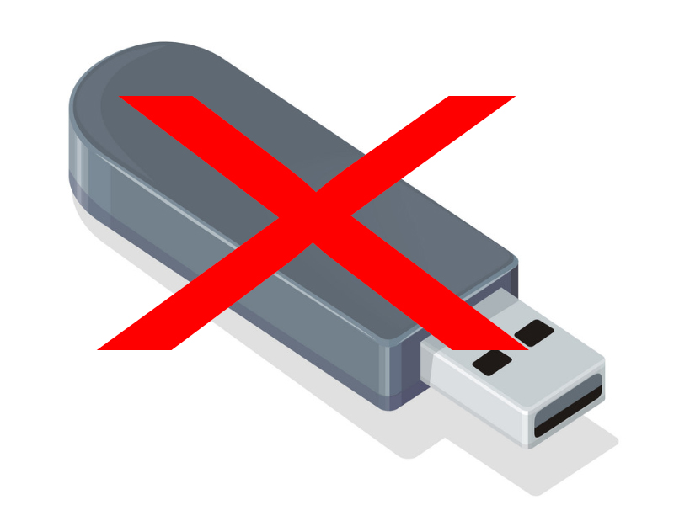
Mitigation
USB policies for devices used in network.
Group policies that would limit the access of most users.
Limiting typing speeds.
Notes:
Block ports by default and approve usage from certain devices over specific ports
The scripts with serious implications that I ran required admin privileges so following the policy of least privileged access will help limit what an attacker can do with the wifi duck.
As you could see, the automated scripts run very fast and the speed of keyboard input is way beyond what a human is capable of so setting up alerts that can catch suspiciously fast keyboard input could help catch these devices in action.

Slide 18
Thanks for listening and good luck to everyone!
Drew Newton

